Slide 1
Feedback for User Metrics and Sales Dashboards
from meeting on 24th Oct 2017
By Terry Karungi
Drafted on: 30 Oct 2017

Slide 2
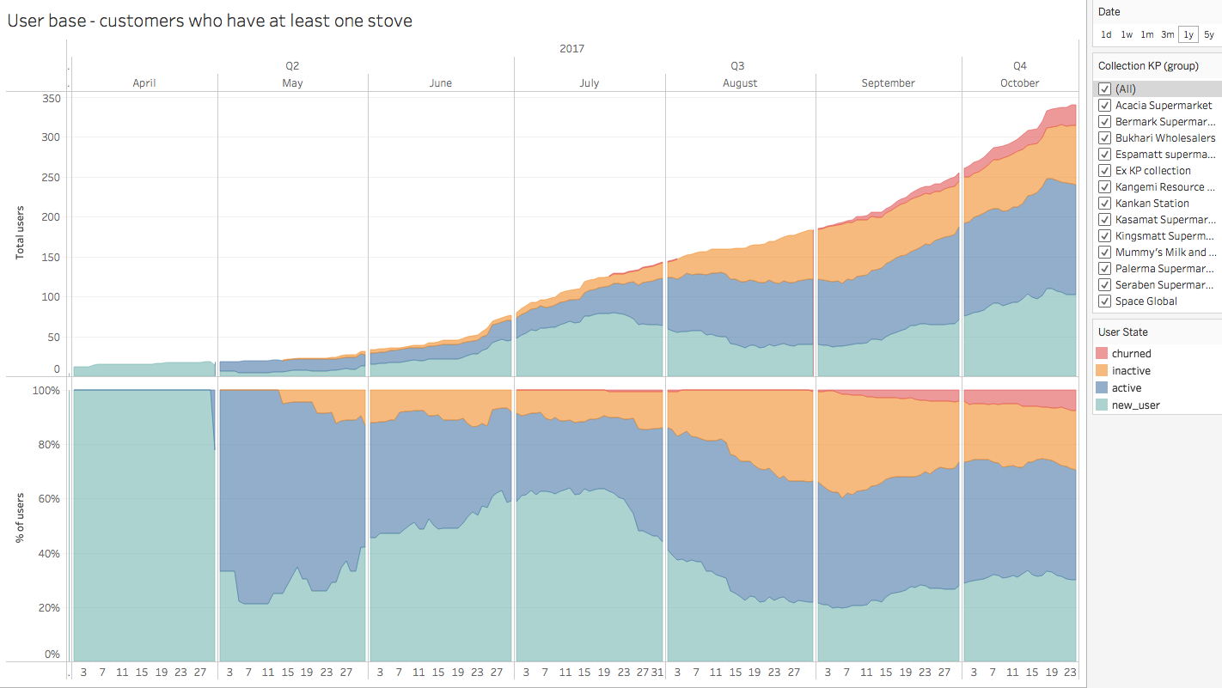
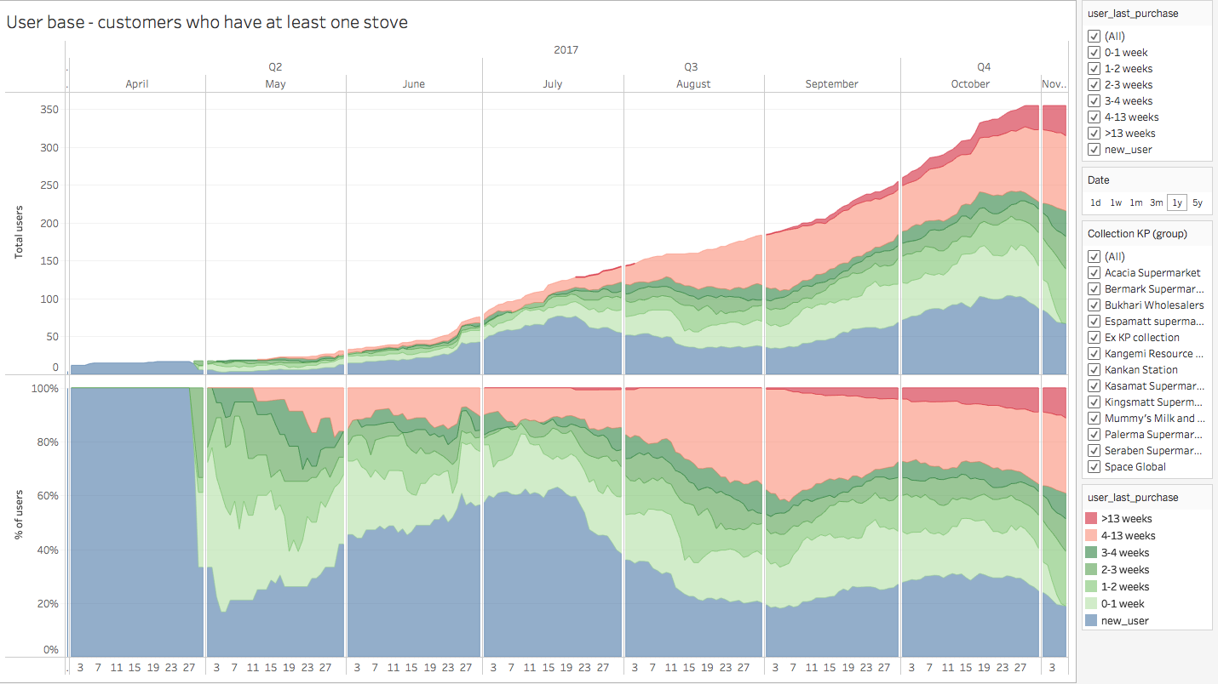
User Base - User Matrix Dashboard
Add last updated date somewhere on the page
Change title to “User base categorized by last fuel purchase for customers with at least one stove ”
Change “Ex-KP Collection” to “Null”
Notes:
Improvements include
Change user states to since when the user last purchased fuel
New users
0-1 week
1- 2 weeks
2-3 weeks
3-4 weeks
4-13 weeks
Over 13 weeks
User states visualisations should be against zero(add filters)

Slide 3
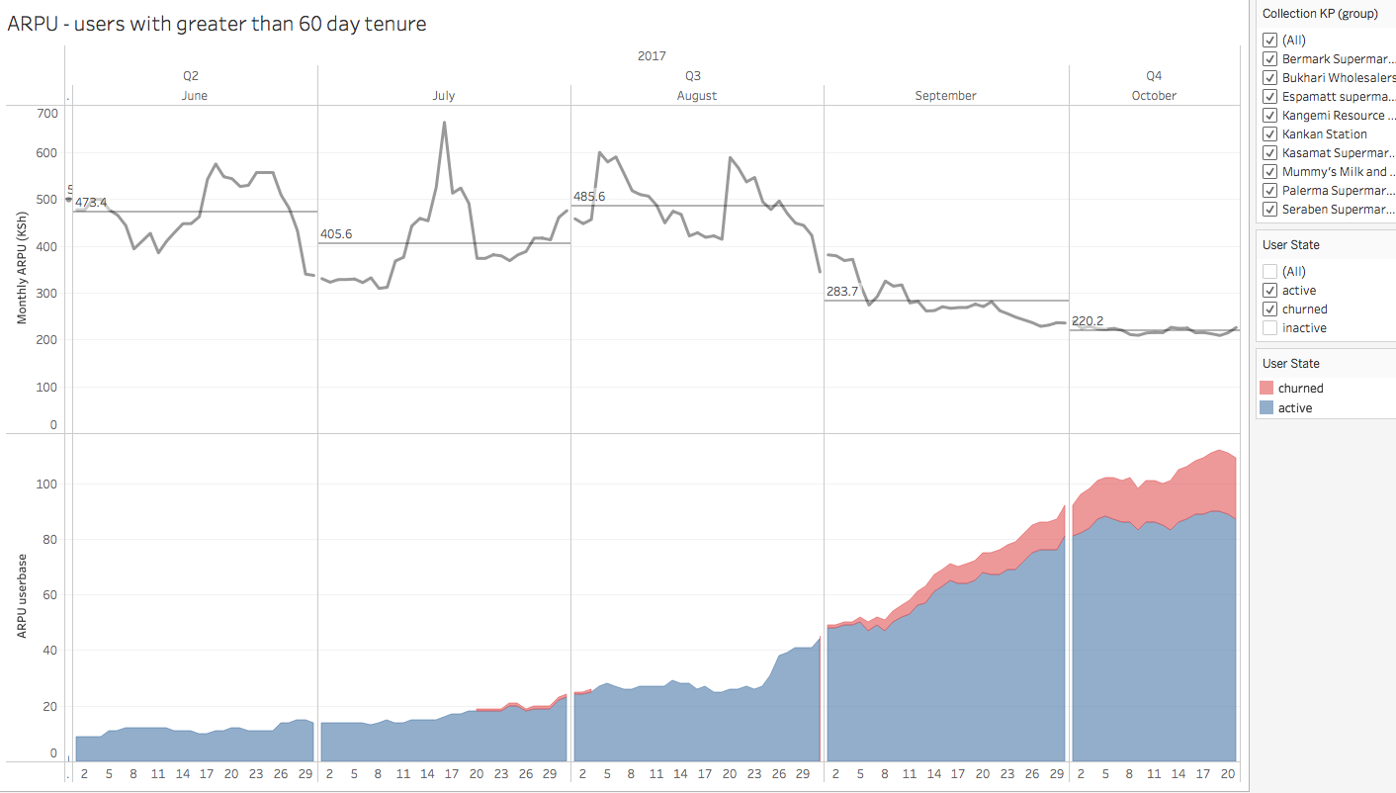
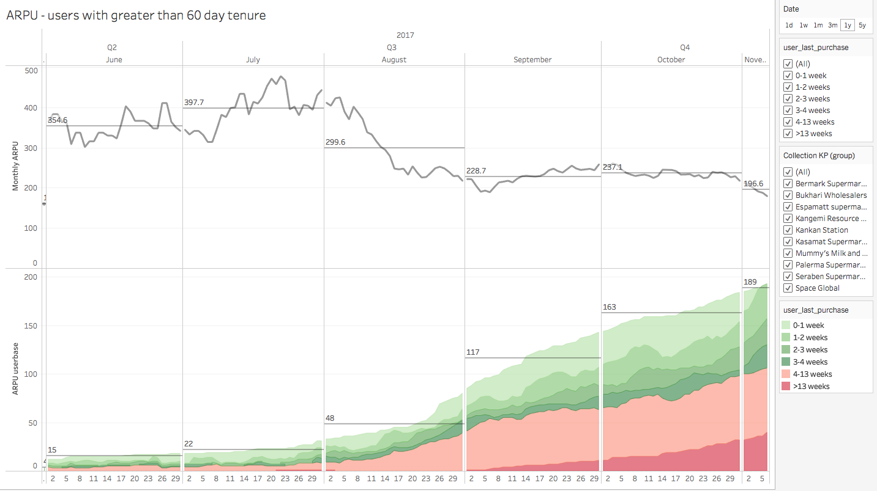
ALPU - User Metrics Dashboard
Change title to “ALPU - users with at least 8 week tenure ”
Tenure should be 56 day - 8 weeks instead of 60 days
Show ALPU (in literage) instead of ARPU as the price is bound to fluctuate
Add last updated date somewhere on the page
Notes:
Improvements include:
7 day doesn't make much sense since we we consider active users those who have bought in the last 28 days. So the 7 day ALPU would be zero for alot of these users.

Slide 4
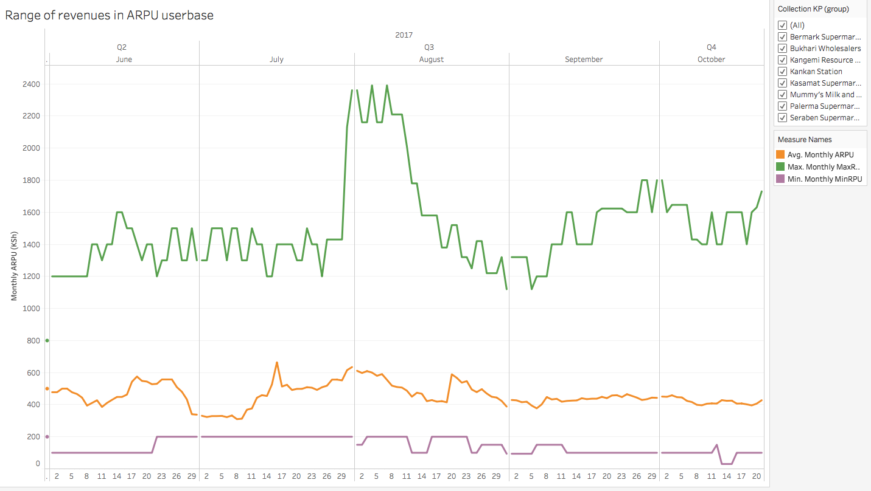
ARPU-Range - User Metrics Dashboard
Change title to “Range of liters in ALPU user base ”
Add 7 day ALPU as well as 28 day ARPU
Show ALPU (in literage) instead of ARPU as the price is bound to fluctuate
Add last updated date somewhere on the page

Slide 5
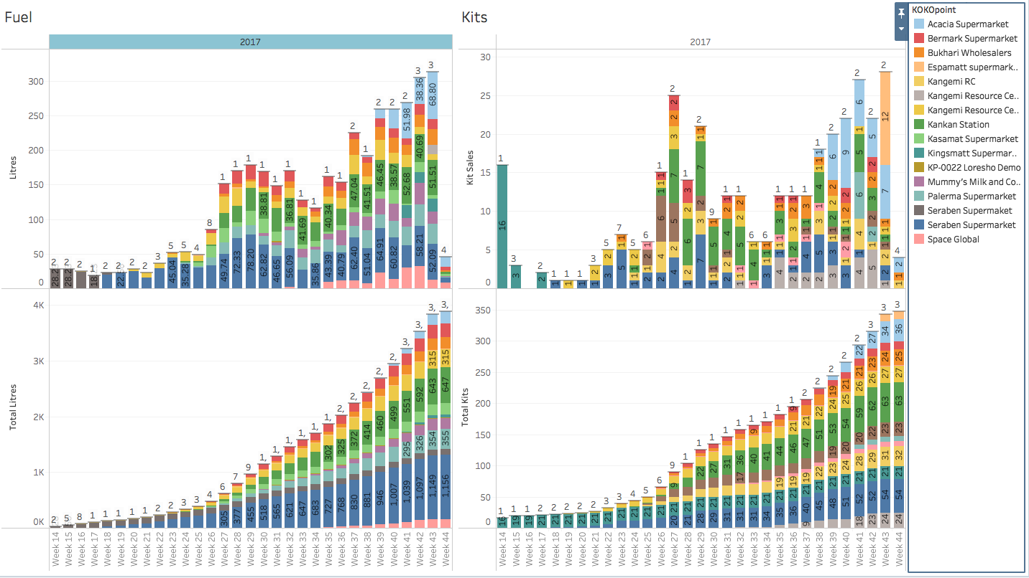
Sales - Sales Dashboard
Too much data being shown, best to aggregate the data and show average kit sales per KP per week
Add time frame filter to the chart
Kangemi Resource Center seems to have 3 separate KP’s. Could we combine this into one
The x - axis not very clear - add weeks in months (as the ARPU dashboard)
Add last updated date somewhere on the page
Add a separate charts (bars or table) to show stove sales and fuels for the last 4 weeks
Add Cash sales vs Savings Sales by week (A cash sale is when a stove is paid for in full through one deposit of 4500)

Slide 6
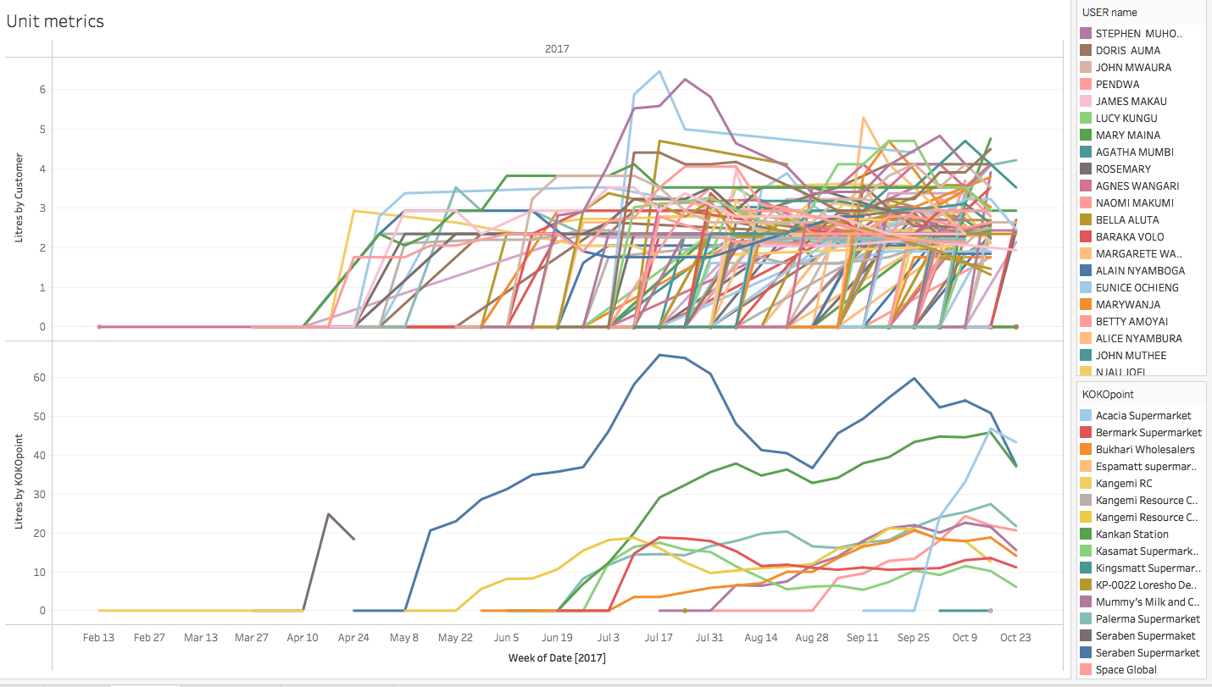
Unit Metrics - Sales Dashboard
Remove litres by customer chart (top chart) - not needed
For the liters by KP chart - aggregate data to show Average weekly litres sold per KP and include max and min range
Change title to “Average Literage sold by KP”
Add time frame filter to the chart
Add last updated date somewhere on the page
Kangemi Resource Center seems to have 3 separate KP’s. Could we combine this into one

Slide 7
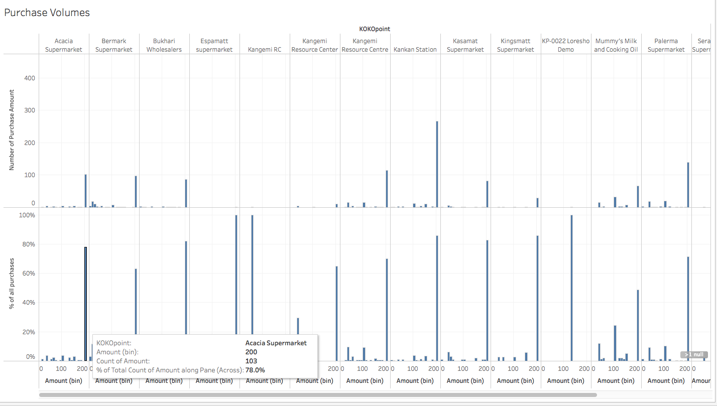
Purchase Volumes - Sales Dashboard
Aggregate data to show Daily purchase size distribution
Change title to “Daily purchase size distribution”
Add a time frame filter to this chart
Kangemi Resource Center seems to have 3 separate KP’s. Could we combine this into one
Add last updated date somewhere on the page

Slide 8
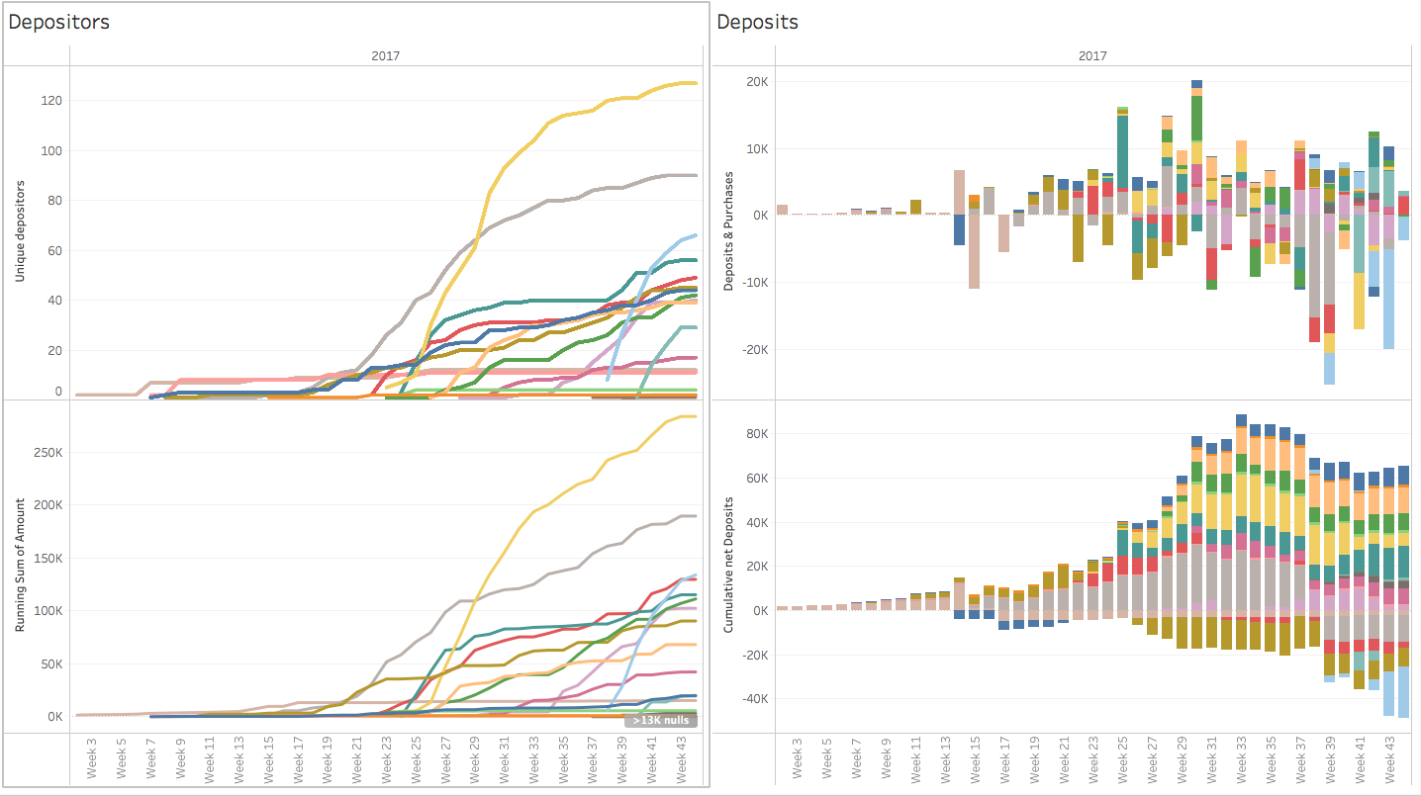
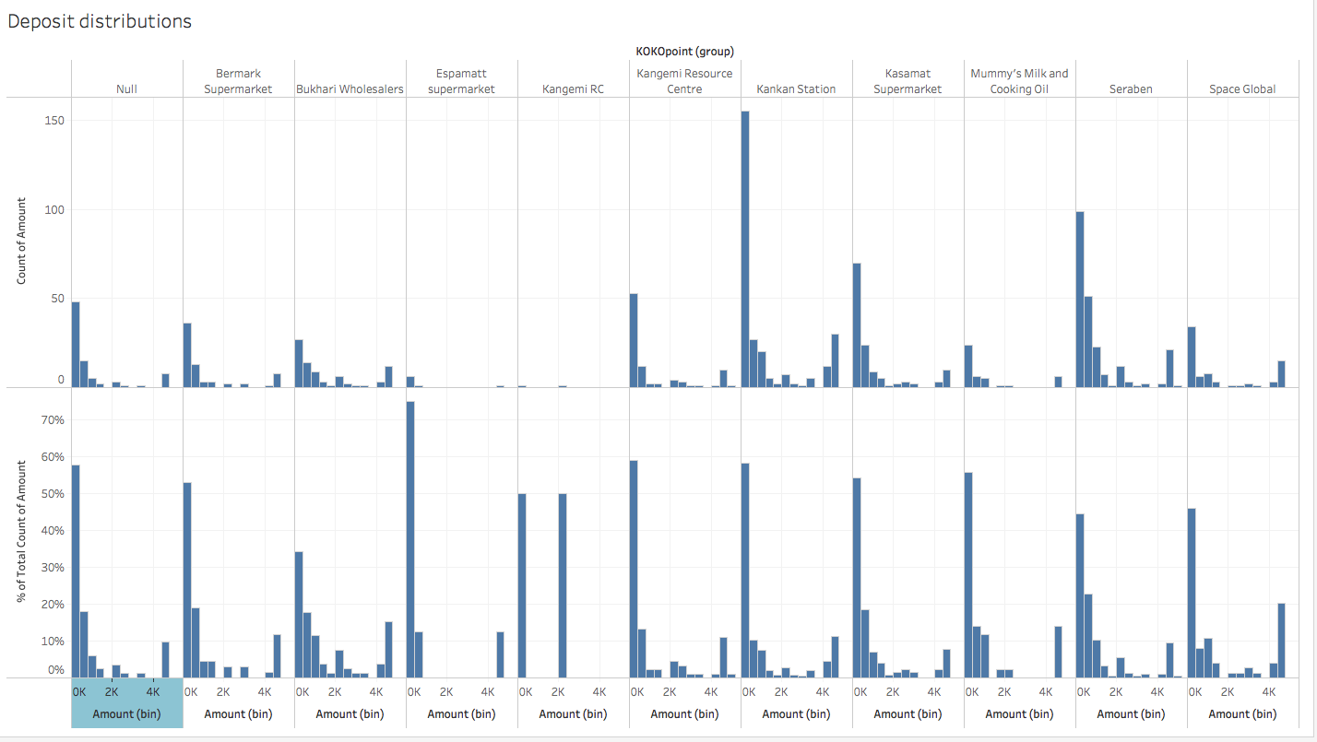
Pipeline - Sales Dashboard
Delete these charts - will be addressed in the Savings dashboard with different visualizations. Data will be aggregated
Deposit Distribution - Sales Dashboard
Delete these charts - will be addressed in the Savings dashboard with different visualizations. Data will be aggregated

Slide 9
General Improvements
Add a glossary with the following terms
User - A customer that has at least one stove
New user - A user that have had a stove for less than 4 weeks
28 day ALPU - Average Liters Per User. This is calculated over the last 4 weeks for users with at least an 8 week tenure.
Collection KOKOpoint - Where a user collected their stove
KP - KOKOpoint
Cash Sale - A stove sale paid for in full through one deposit of 4500
Savings Sale: A stove sale paid for in full through more than one deposit.

